Slide 1


Project 1
Comparative analysis of Ohio graduation rates and select social economic data, 2002 - 2018
Project Group: Jasmine Jones, Neda Mehdizadeh, Anthony Stevens & Benjy Manning

Slide 2
Outline
Introduction/Objective
Tasks
Cleaning data sets
Merging data sets
Visualizing the data
Statistical analysis
Results and discussion
Conclusions

Slide 3
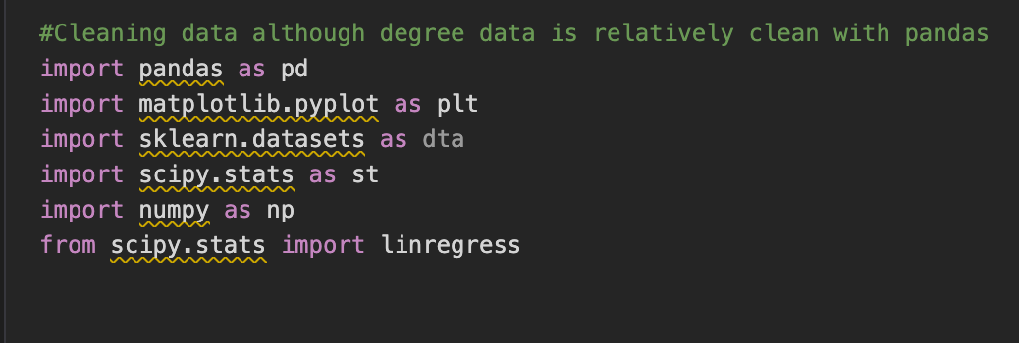
Objective
Investigation of the relationships between the college graduation rate, family income and poverty rate in the state of Ohio using the following Python Libraries:

Slide 4
Sources of Data
Three data sets were obtained, merged and cleaned in the Jupyter notebook with Pandas library:
Median Income and Unemployment data was obtained from the USDA online: (https://www.ers.usda.gov/data-products/county-level-data-sets/download-data/ )
Ohio College Graduation data was obtained from the Ohio Department of Higher Education: (https://www.ohiohighered.org/data-reports/degrees)
Poverty rate data was obtained from the US Census bureau: (https://www.census.gov/data-tools/demo/saipe/#/?map_geoSelector=aa_c&s_state=39&s_year=2019,2018&s_measures=aa_snc&map_yearSelector=2018 )

Slide 5
Initial thoughts on data
We did not expect to be such a large correlation between median income and number of degrees earned.
No expected correlation between poverty rate and degrees earned.
As degrees earned rises, the unemployment rate goes down.

Slide 6
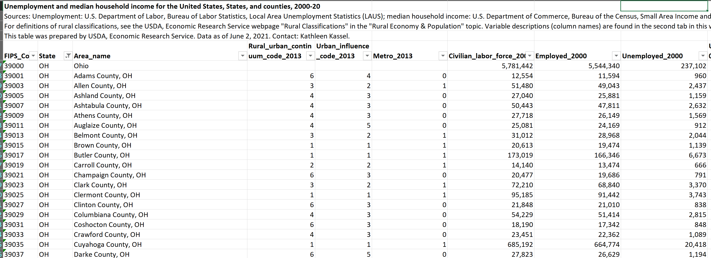
Unemployment and Median Income Data Set

Slide 7
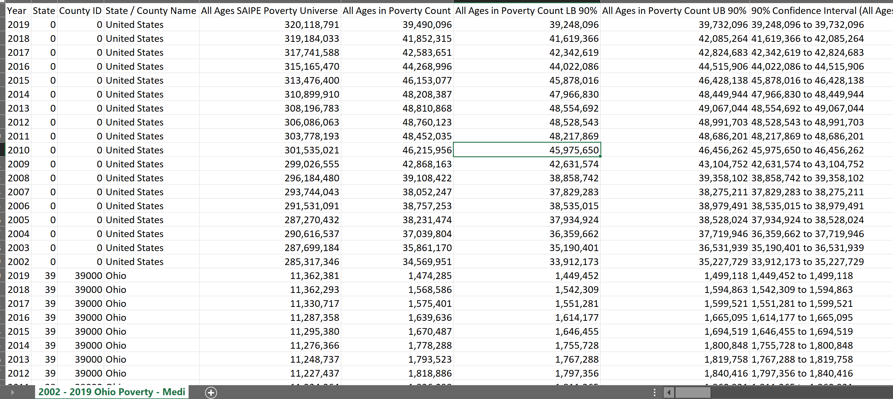
Poverty Data Set

Slide 8
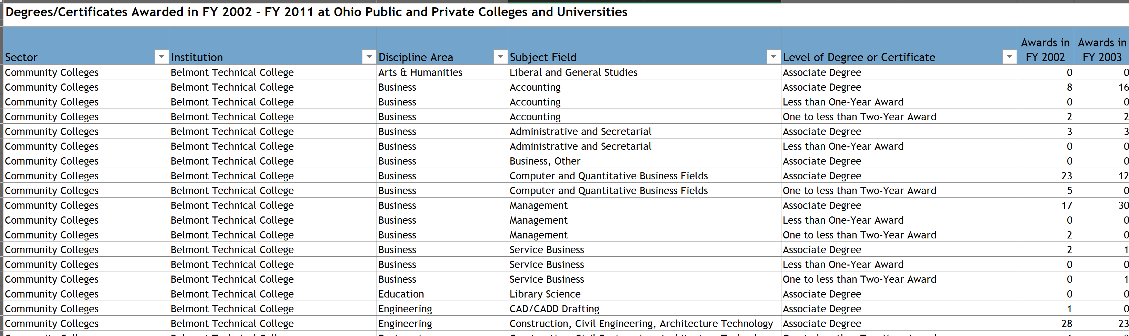
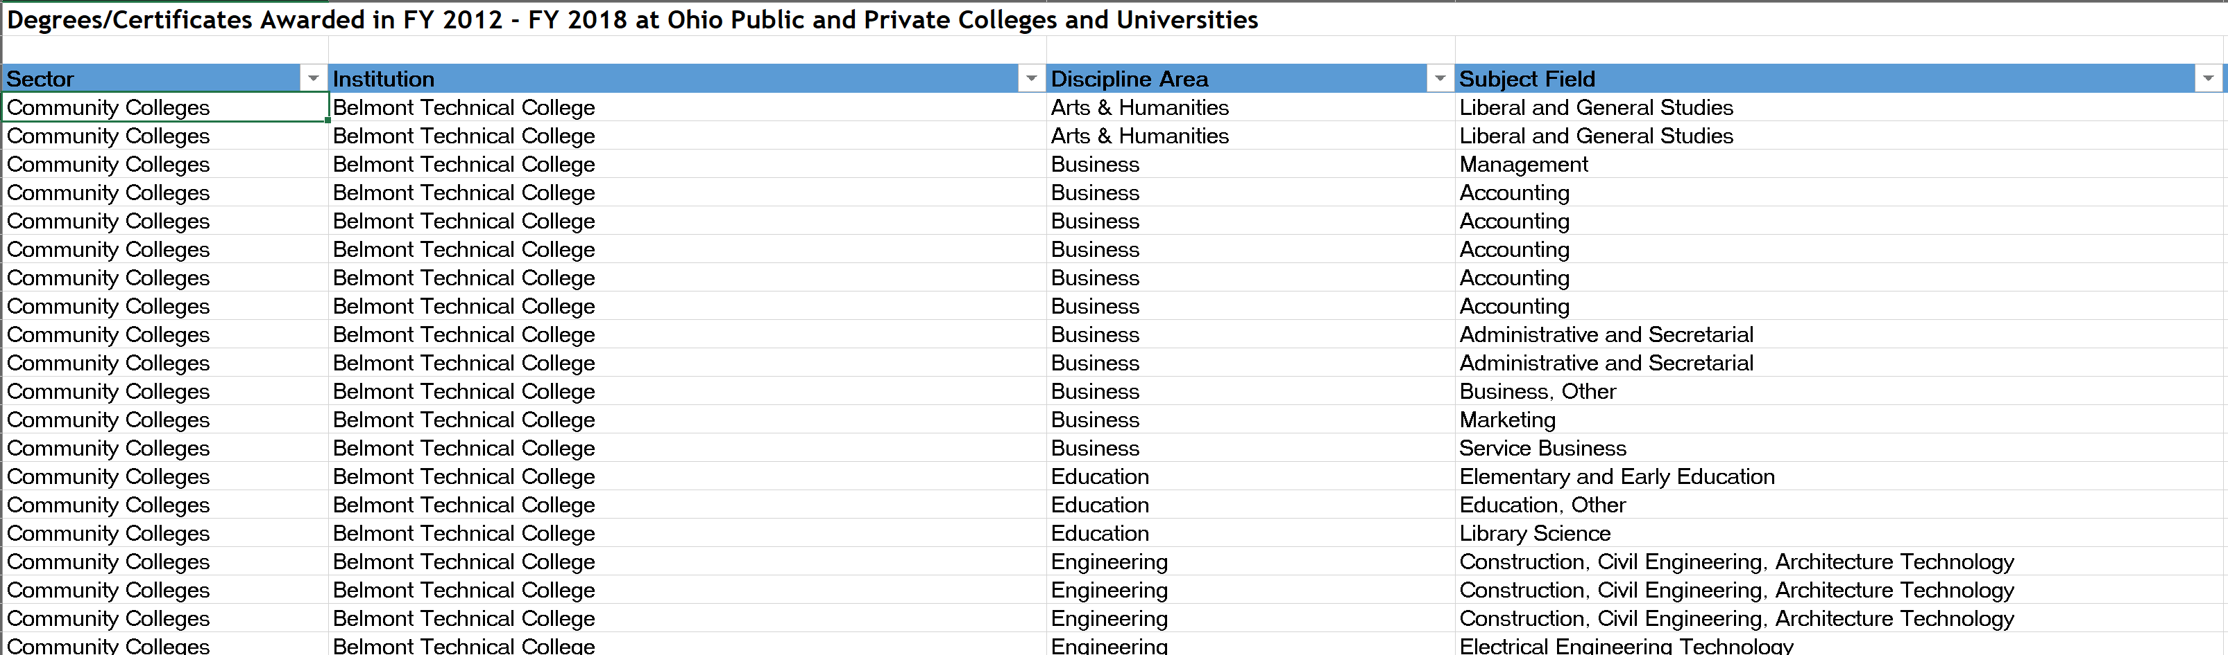
College Graduation Data Set

Slide 9




Data Import and Cleaning
Imported all data sets for cleaning
Renaming columns in all data sets to be more meaningful to analysis
Dropping columns to only use relevant data to analysis
Adding summary columns for total degrees
Adding average unemployment rate for the states and separating for Ohio only
Sample Code:

Slide 10
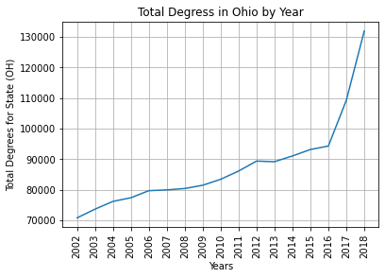
Total Degrees Data Observations – by Year

Slide 11
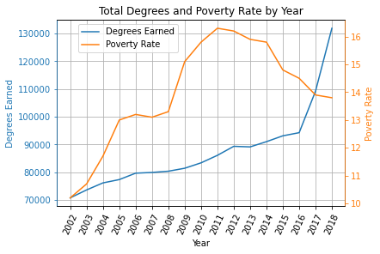
Question 1: Does the poverty rate have an impact on the number of degrees from 2002-2018 in Ohio earned?

Slide 12
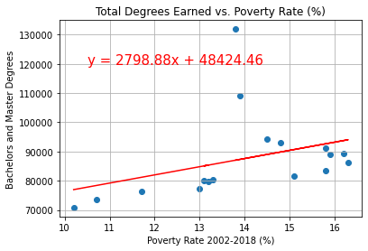
Throughout our analysis there seemed to be a slight correlation between the states poverty rate and the number of degrees earned. Perhaps, as poverty rose, less people were attending school. The correlation was calculated at 0.36, again, suggesting a slight correlation.

Slide 13
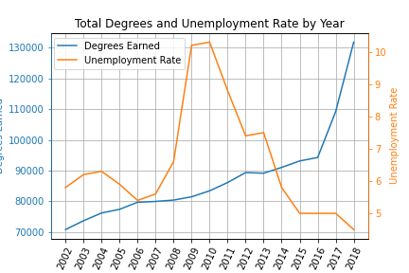
Question 2: Did Ohio’s unemployment rate have an impact on the number of degrees earned from 2002-2018?

Slide 14
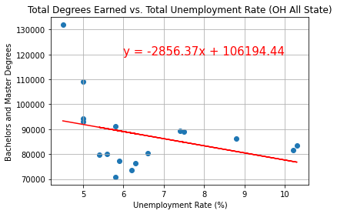
After the analysis was completed, there was no correlation between the unemployment rate and the number of degrees earned. This metric had the lowest correlation of all our calculations. The correlation was calculated at -0.34. Although there looks like there could be a correlation in certain years, the overall data tells a different story.

Slide 15
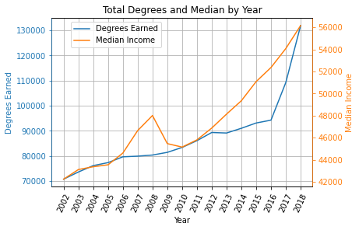
Question 3: Did the median income from 2002-2018 impact the number of degrees obtained?

Slide 16
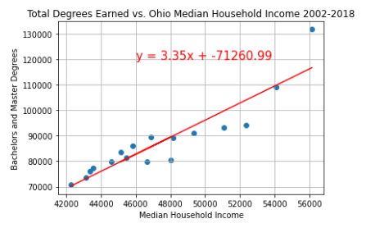
R²= 0.92
Out of all three correlation comparisons, this one was the most surprising. There significant correlation between the median income and the number of degrees earned.
The data suggests that the higher the median income the more likely there are going to be college graduates that year.

Slide 17
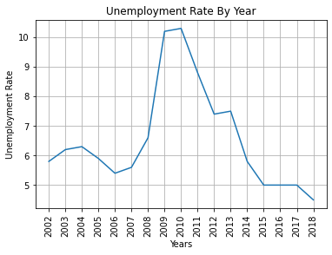
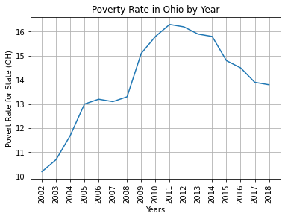
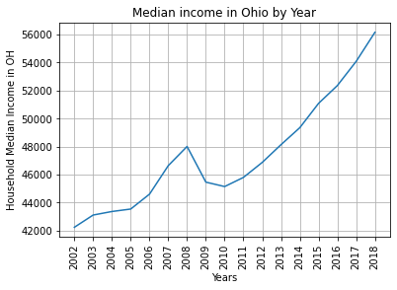
Data Summary – by Year

Slide 18
Summary & Conclusions
Median Income, Unemployment data, poverty rates and Ohio College graduation data were obtained from 4 different resources
Data were imported, cleaned and combined in Jupiter notebook with the aid of Pandas data frames
Number of college graduates with bachelors and master’s degrees increased steadily and almost doubled in 2018 compared to 2002
Unemployment was highest during 2009 -2010 (during and right after great recession years)
Poverty Rates were the highest during 2010-2013
Median Household income decreased during 2008-2011 and started increasing 2011
Significant correlation was observed between number of degrees obtained and Median Household income

Slide 19

Thank you for your attention!

